Slide 1
AWCBC Safety & Prevention Committee
BC Jurisdictional Update
April 2014

Slide 2
Agenda
Sawmill Explosions
Combustible Dust
Certificate of Recognition
Confined Spaces Centre of Excellence
HSA Accountability
BC Safety Charter
Risk Analysis Unit

Slide 3
Sawmill Explosions

Slide 4
Timeline
January 20, 2012: Babine Forest Products near Burns Lake in northern BC. Two workers died and 20 were injured, many very seriously.
April 24, 2012: Lakeland Mills near the city of Prince George. Two workers died and 22 were injured, many very seriously.
Cause: combustible wood dust and an ignition source at a low level.
Jan 2014 and April 2014: Crown Counsel declines to proceed to criminal charges under Act.
April 2014: WorkSafeBC penalizes Babine $97,500 and imposes claims cost levy of $914,139.

Slide 5
Combustible Dust

Slide 6
Phase 4 of Combustible Dust inspections
GOAL: to evaluate an employer’s dust management program and ensure that program is sustainable and compliant.
144 mills (including pellet and OSB mills)
Includes 61 mills that had a previous order penalties
Began April 7th and will continue till end of June (approximately)
Focus on “secondary” dusts (i.e. drier, finer dusts that have settled away from production areas), that are present at a depth of 1/8” or more, over 5% of a given work area
Non-compliance will lead to
Stop Work and Compliance orders
Accelerated Enforcement protocol
Consideration of Penalties

Slide 7
90-Day Action Plan
Implemented on March 31, 2014
Government (Ministers of Labour & Forests), sawmill industry leaders, Steelworkers union, small/independent mills, WorkSafeBC, and other regulators.
Outcome: 9 agreements – done in 90 days
Much achieved on all fronts by April 2014.

Slide 8
90-Day Action Plan
Most notable:
COFI membership dependent on commitment to compliance and audit tool;
Audit tool offered by MAG to all mills
Awareness campaign re: CD and Right to Refuse Unsafe work
Expert Industry Advisor Initiative
Training in CD control and mitigation to be offered by big industry to small industry
WorkSafeBC to consider audit tool elements in an enforceable policy
WorkSafeBC to review its policies around high risk violations and consequences for non-compliance

Slide 9
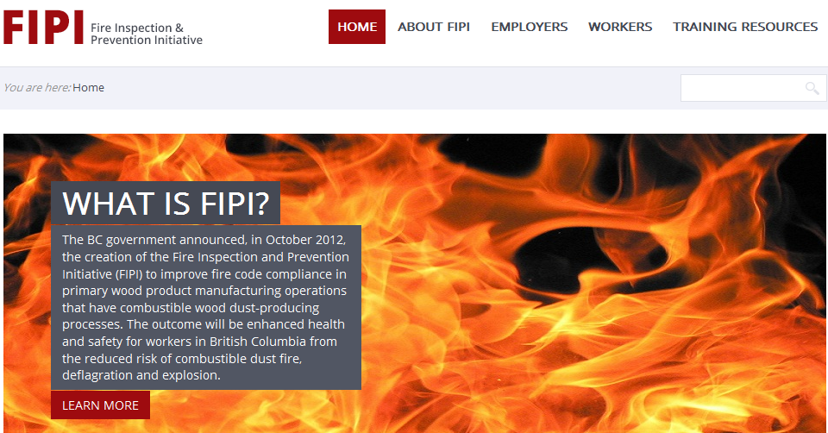
Sawmills/Combustible Dust
Q 2/3 of 2014: Fire Inspection and Prevention Initiative (FIPI) completed and excellent resources created
http://www.fipibc.ca/

Slide 11
Sawmills/Combustible Dust

Slide 13
Certificate of Recognition

Slide 14
Certificate of Recognition
RTW incentive program frozen on January 2013.
2013 Plan: Complete re-build of RTW program
Extensive research DONE in 2013
Extensive consultation DONE in 2013
Create new principles and Elements DONE in 2013
Create new Guideline UNDER CONSTRUCTION in 2014
Create new Audit Tool UNDER CONSTRUCTION in 2014
Audit Tool testing – Q3 2014
Audit Tool training – Q4 2014
Roll out....early 2015?

Slide 15
Confined Spaces Centre of Excellence

Slide 17
HSA Accountability

Slide 18
Accountability, Leading Indicators, and Outcome Reporting
8 Question Safety Culture Survey: WorkSafeBC is working with Dr. Chris McLeod (UBC’s Partnership for Work, Health & Safety) on pilot in BC
ILS Teams – Accountability and Outcomes. New focus on project management for all industry prevention work.
Project Mgmt Model: GOAL + WHY + HOW (activities) + Expected Outcome + Measurement + Review
HSAs: same project management model as ILS Teams
April 10 – half-day HSA “Summit” with senior leadership.

Slide 20
BC Safety Charter

Slide 21
Purpose:
To bring together CEOs who understand that effective management of health and safety is essential to the long term profitability and sustainability of their companies and spread the message to other corporate leaders
Continues to grow
As of April 2014 – 112 signatories from 107 organizations.

Slide 22
Risk Analysis Unit

Slide 23
Prevention Review
Malcolm K. Sparrow: Professor of the Practice of Public Management at Harvard, expert on regulatory process, regulation design, risk management, etc…
Worked with WorkSafeBC in 2013 to review our Prevention program
Question: How to foresee and devise Prevention strategies around catastrophes that have not yet happened?
Claims data vs ?

Slide 24
Risk Analysis Unit
First new initiative arising out of Sparrow report January 2014
The role of the Risk Analysis Unit is to:
Identify non-aligned risks before the harm is done
Develop new approaches to reducing those risks
Consider under-served aligned risks

Slide 25
Non- Aligned Risks
Non-aligned risks are those risks for which claims are not an effective indicator for importance:
1. Serious but non-monetary losses
Where there are many years between the initial cause of harm and the onset
2. Slow acting harms
Where there are many years between the initial cause of harm and the onset
3. Catastrophic risks
Risks that seldom materialize but have the potential to cause widespread damage or loss of life

Slide 26
4. Invisible Risks
Risks that aren’t fully revealed and may be hard to detect
5. Conscious opponents
Risks created by people who deliberately seek to avoid regulatory measures
6. Emerging Risks
Long term, uncertain trends that aren’t urgent yet, but may be important

Slide 27
Risk Identification & Analysis
Aligned Risk Data (reactive):
Claims
Incidents
Near misses
First aid reports
Unaligned Risk Data (proactive):
Experience from prevention officers
Experience from industry professionals
Incidents nationally or internationally
Emerging trends in disease data
Emerging safety issues previously unknown
Horizon issues – what is coming at us in the future

Slide 28
Stepped assessment process/criteria
First level
Hypothesis: What is the risk?
Scope: Is this risk within scope of RAU?
Familiarity: How well do we understand the risk? A little or well?
Importance: How important is this risk?
Criteria 1: potential for fatalities
Criteria 2: potential for serious injuries
Criteria 3: catastrophic risk
Criteria 3: reputational risk
Urgency: How urgent is this risk?
Link: Does the risk fit with current priorities of RAU / other parts of org?
Assessment 1: Do we continue assessing this risk?

Slide 29
Mitigation Strategies
Establish mechanism/approach to develop unique mitigation approaches that take into account the size and shape of the risk as well as the frequency and drivers
Develop enforcement framework with field officers

Slide 30
THANK YOU!
Questions?

