Slide 1

BC Safety Charter
2011-2015
AWCBC Meeting May 25, 2015

Slide 2


Notes:
Who is FIOSA MIOSA and why they started the BC Safety Charter and continue to support it…

Slide 3
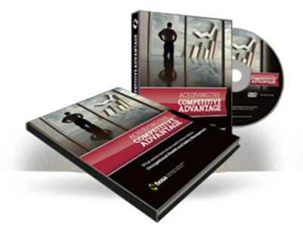
2008 Consultations

Slide 4
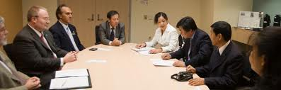
2010 CEO Advisory Committee
“Industry led – Industry supported”
“Safety is a Core Value and not just a priority …
priorities change yet values do not”

Slide 5
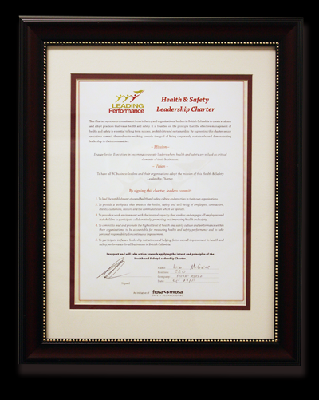
2011 Launch BC Safety Charter

Slide 6
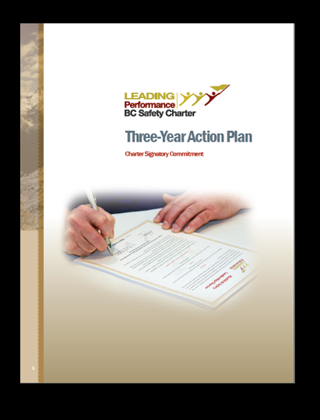
2012
3 Year Action Plan
BC Safety Charter Steering Committee

Slide 7

      BC Safety Charter Steering Committee
      Ben Hume, (CHAIR) President of Sheppards Building Materials
      Dan Reader, President of Murray Latta Progressive Machine Inc.
      Sandra Oldfield, President & CEO of Tinhorn Creek Vineyards
      Matt Williams, President of Williams and White
      Rick Gibbs, President of Neutron Factory Works
      Lisa McGuire, CEO of FIOSA-MIOSA Safety Alliance of BC

Slide 8
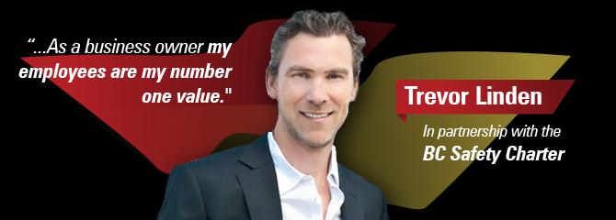
2013 Ambassador

Slide 9
2013
BC Safety Charter Model
Governance

Slide 10
2013
BC Safety Charter Model
Strategy

Slide 11
2013
BC Safety Charter Model
Marketing and Engagement Outreach

Slide 12
2013
BC Safety Charter Model
Education, Best Practices and Mentorship

Slide 13
2013
BC Safety Charter Model
Standards, KPI Measurement and Recognition

Slide 14
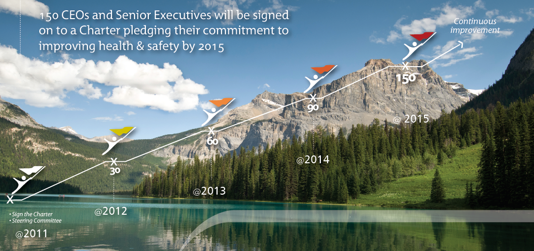

Slide 15

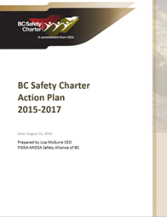
2014 Action Planning Session

Slide 16
2014 Action Planning Session
Vision – 2025
“All British Columbia business leaders value and create a culture of safety and well-being, making our province the safest place to work and live in Canada.”

Slide 17
Mission – 2025
“Ensure every business leader in BC is actively engaged in delivering on the commitments of the BC Safety Charter”

Slide 18
Core Values
We believe in:
Active Participation
Commitment
Accountability: to deliver on the five commitments of our BC Safety Charter

Slide 19

Key Performance Indicators
1. Total number of signatories to the BC Safety Charter.
(150 by 2015; 180 by 2016; 210 by 2017)
2. Percentage of CEO signatories that participate in activities each year.
(80% by 2015; 85% by 2016; 90% by 2017)
3. The number of FIOSA-MIOSA member organizations where the CEO has signed the BC
Safety Charter. (80% in 2015; 80% in 2016; 80% in 2017)
4. Percentage of signatories who are actively pursuing, or have achieved OSSE or
equivalent certification. (60% in 2015; 70% in 2016; 80% in 2017)
5. Scoring improvement levels of organizations that have completed the KPI Improvement
Index. (A positive trend improvement should be identified each year.)
6. Higher safety performance results by charter member organizations compared to non-signatory organizations in
BC. (A statistically significant increase in safety should be identified each year)
7. Year-over-year net revenue improvements from Charter Programs and Services.
(10% more revenue in each subsequent year for 2015; 2016; 2017)

