Slide 1
Motor Vehicle Incident Research in Alberta
AWCBC Presentation
May 27, 2015
Dr. P. Karpluk MD, FRCPC (occm)
Director of Medical Services OHS
Jobs, Skills, Training and Labour

Slide 2
Transportation incidents are the leading cause of workplace incident fatality

Slide 3
Work-Related Incident Fatalities 2001-2010

Slide 4
OHS Act
Employers are required to notify of injury or accident that:
Results in death
Results in admission to hospital for more than 2 days
Required:
To carry out investigation into circumstances surrounding the serious injury or accident
To prepare report of circumstances and corrective action to prevent recurrence
To ensure report is available for inspection by officer
NO EXCLUSION CLAUSE for injury or accident resulting from MVI

Slide 5
WCB Accepted Claims 2002-2012
By Source
Total Fatality | 1302
Workplace Motor Vehicle Fatality | 353
Average | 32/year
Workplace Motor Vehicle Hospitalization
Greater than 2 days | 1328
Average | 121/year
Time Loss MVI Claims
Average 1500 – 1800 / year

Slide 6
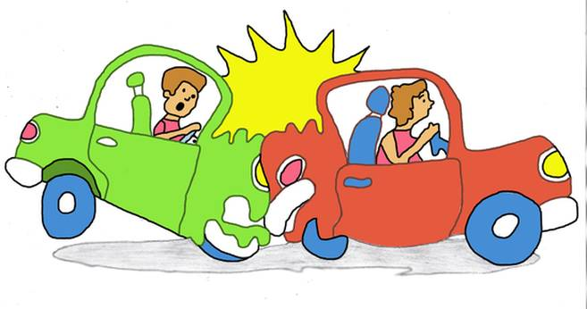
Why MVI’s?
Leading cause of work-related fatalities and hospitalizations <2 days

Slide 7
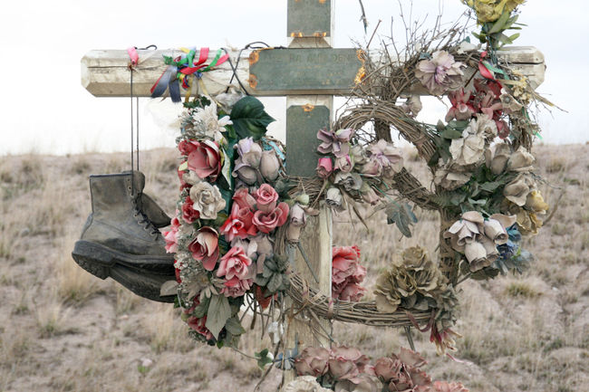
Occupational Motor Vehicle Incident Fatalities 2004-2008
7

Slide 8
Occupational Motor Vehicle Incident Fatalities 2004-2008
WCB Accepted MVI Fatalities (155)
+
AB Transportation Collision Report
+
Chief Medical Examiner Fatality Report
=
143 Files

Slide 9
Dr. Jeremy Beach – University of Alberta Occupational Medicine
AB Centre for Injury Reduction and Prevention
Don Voaklander
George Frost
Significant factors in circumstances associated with fatalities

Slide 10
143 Fatalities
122 work – related drivers
214 total drivers involved
81 Single Vehicle Fatalities
Off-Road Right | 43%
Off-Road Left | 31%
62 Multiple Vehicle Fatalities
Head-On | 26%
Right Angle | 24%
Rear-End | 19%

Slide 11
143 Fatalities
Male 95%
Drivers 85%

Slide 12
122 Driver Fatalities
35 - 44 years old 31%
25 - 34 years old 23%

Slide 13
Work-Related Fatality Vehicles
Tractor-Trailer/Semi | 40%
Pick-up/Van | 28.5%
Car | 12%
Truck > 4500kg | 7%
Vehicle Status
No Mechanical Defects | 88%
Tire Failure | 3.3%
Brakes / Steering Defect | 1.4% / 1.4%

Slide 14
Time of Fatal MVI Incident
6am – 11am 43%
Noon – 5pm 27%
Incidents increase Sunday through Thursday

Slide 15
Roadways
Secondary Highways 57%
Primary Highways 20%
Paved Highways 83%

Slide 16
Road Surface
Dry | 63%
Slush/Snow | 10%
Ice | 9%
Wet | 6%
Environmental
Clear | 73%
Blowing Snow/Cloudiness | 15%
Fog/Dust/Smoke | 6%
Snowy | 6%

Slide 17
Seatbelt Use
Fatally injured drivers & passengers 40%
Fatality not wearing seatbelt ejected 59%

Slide 18
Impairment Noted on Collision Report
Alcohol 4%
Drug 1%
Toxicology Testing
Alcohol | 95% tested | 15.5% positive
Drugs | 69% tested | 25% positive
 | 15.5 % | THC
 | 10.7% | Benzodiazopines
 | 6% | Cocaine

Slide 19
Follow-up Activity
Extension of MVI Fatality Review
5 year 2009 – 2013 Same Parameters
10 year 2004 – 2013 Additional Items
Geoplotting

Slide 20
Follow-up Activity cont’d
Support
Executive Directors Policy and Delivery
ADM
Policy
Investigation of Work-Related Motor Vehicle Accidents
Develop Pilot Project
MVI Fatality & Hospitalization

Slide 21
Follow-up Activity cont’d
Employer Incident Report Information
OHS Officer review
Cumulative Data
General Info
Incident Info
Employer Policy Info
Legislation Compliance

