Slide 1
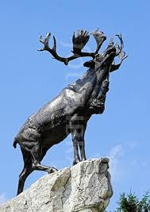
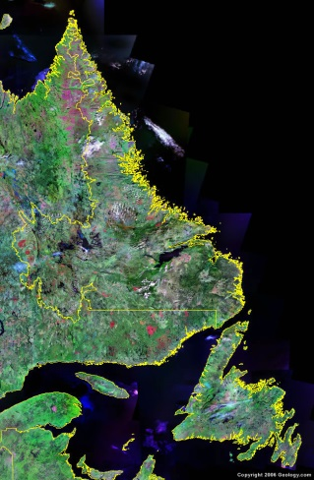
Implementing a Prevention Plan in Newfoundland and Labrador

Slide 2
Our Vision
Safe and healthy workplaces within a viable and sustainable insurance system which reduces the impact of workplace injuries by providing the highest level of service to workers and employers.

Slide 3
With a dedicated staff of 390 people,
the Commission covers 98% of the working population, serves over 19,000 employers, 220,000 workers, from three locations:
St. John’s, Grand Falls and Corner Brook

Slide 4
Prevention
Promote awareness of workplace health and safety
Foster commitment and provide education to stakeholders
Develop standards for the certification training
Targeted prevention services to priority employers and industries
Initiatives
Sectoral Safety Councils
Prevention Plan
Youth Strategy; Who Wants to Save a Life? Game Show Prevention Strategy; Occupational Disease Strategy
CEO Safety Charter
Employer Services

Slide 5
Sector Safety Councils
Notes:
NLCSA established in 1996
FSANL 2009
NLFHSA 2012
MSCNL established in 2012

Slide 6
Sector Council Program
Sector Advisor Program established in 2007
Sectoral Council Funding Guidelines established in 2008
Developmental Funding
Phase 1 Funding for business plan development
Phase II Funding –
Year 1, 2 and 3 business plan implementation
Sector Council Program Review undertaken in 2013

Slide 7
Focus on Youth
Increase safety education and training of young workers
Enhance the Workplace Safety 3220 curriculum
More module-based curricula for high school courses
Increase online delivery of safety training for high school students.
Continue promotion of the:
Game Show
Radio/Video Ad Contest
HS Educator of the Year

Slide 8
SAFEWork NL’s – Who Wants to Save a Life?
Started in 2008 in partnership with FINALY and Department of Education
Fast-paced, interactive learning
Creates an engaging, educational experience
Give young workers knowledge to prevent injuries
Link to curriculum and learning outcomes
Effective educational tool for raising awareness about workplace safety
Four Formats: Classroom, Full Venue, Studio, Distance Learning
Viewing audience of over 90,000 across the Province this Fall.
Additional 50,000 viewers on Eastlink TV
Annual Evaluation
25,000 students have participated in the game show, from over 100 schools with over $100,000 in cash prizes/scholarships

Slide 9
A Strategy for the Prevention of Known Occupational Disease 2011-2013
A partnership approach
Preventing workplace injuries, illnesses and occupational disease is everyone’s responsibility.
13 Month Consultation Process
Cross Jurisdictional Review
Input from Employers, Labour, and Safety Sector Councils
Occupational disease prevention is difficult work
Long term, sustainable effort is required
Increase awareness, education and enforcement
Invest in human resources/capacity planning in ODP
Awareness will increase claims
Families deserve fair compensation
Worker protection has to be the primary goal
What We Heard

Slide 10
Development of an Occupational Disease Strategy
Year One
Build safety partnerships to plan ways to provide education on the prevention of known occupational disease
Year Two
Implement targeted education and awareness initiatives about occupational hazards and exposures that can cause occupational disease
Year Three
Continually monitor progress in order to set future directions for the prevention of occupational disease

Slide 11
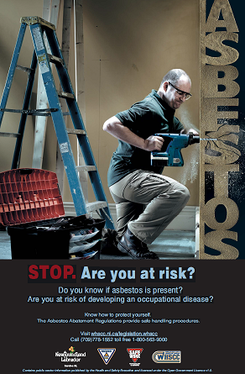
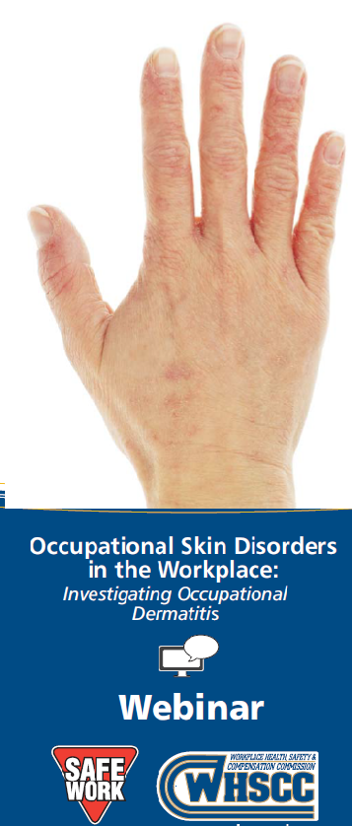
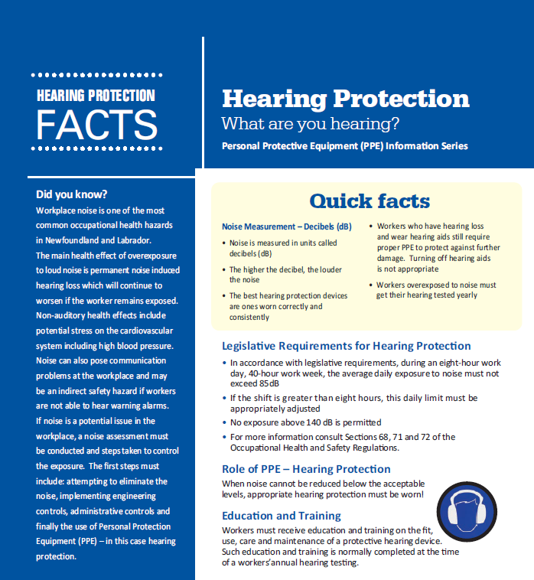
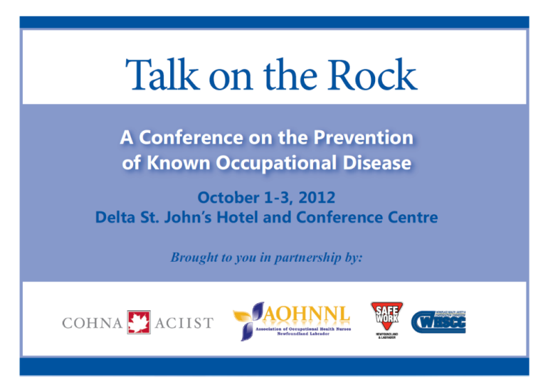
Awareness
Education
Notes:
Awareness - Focus on five key health hazards: Asbestos, Silica, Chemicals, Fumes, Noise, Print and Radio ads
Two waves completed in 2013/14, 6 week duration per wave
Education - Fact Sheet Development: Noise, PPE and Hearing Loss, Heat Stress, WHMIS,
New curricula for Workplace Safety 3220 high school course, Occupational Health, Hearing Conservation, Mental Health, WHMIS
Hosted National Conference on Occupational Disease Prevention
St. John’s, October 1-3, 2012
Partnered with COHNA and AOHNNL, 190 delegates
Workshops - Occupational Disease Prevention: The Fundamentals, Noise Induced Hearing Loss at Work: Implement a Hearing Conservation Program, Work-Related Asthma
Known Occupational Disease in our Workplace: How to Protect Yourself
Webinars
Skin Disorders in the Workplace – Investigating Occupational Dermatitis, Determining acceptable exposure limits when working with chemicals, Carbon Monoxide
Mould in the Workplace
Chemical Exposure in the Workplace
Commission hired Epidemiologist and Industrial Hygienist in 2012
Outreach Program to employers with high rates of occupational disease
Work with research agencies i.e. IRSST, SafetyNet, WorkSafeBC
Data quality and quality assurance
Injury trending, mortality and morbidity

Slide 12
CEO Safety Charter
CEO Safety Charter - Leaders in Safety – established in 2007
Supports the continuous improvement of healthy and safe workplaces throughout our province.
Ambassadors for safer workplaces demonstrate their commitment to the prevention of accidents and promotion of health and safety in the workplace.

Slide 13
We’re building a culture of safety in Newfoundland and Labrador

Slide 14
In the past 10 years
Employer satisfaction has increased by 31%. It’s now at 79%
The average assessment rate has decreased from $3.24 to $2.45
In 2014, 99.8% of employers will see a decrease in their assessment rates
There has been an increasing investment in on-line services and programs for employers

Slide 15
91% of employers are injury free

Slide 16
Youth are leading the way
when it comes to safety
in this province with a
lost-time incident rate of 1.4

Slide 17
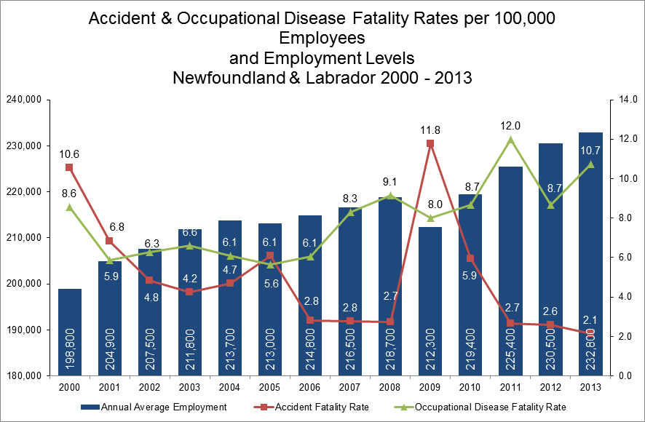

Slide 19
The number of occupational health and safety committees have tripled in the past 10 years
New standards have been developed in traffic control, fall protection and confined space

Slide 20
Starts with Me

