Slide 1
Present to the AWCBC Prevention Subcommittee
Office of the Chief Statistician, WSIB
April 30, 2014
New Selection Model for the Workwell Program

Slide 2
Outline
Background
New Selection Model - Approach
Validation of the New Model
Next Steps

Slide 3
Background
Workwell program identifies high risk employers to conduct Health and Safety Performance Reviews and work with employers to develop a Risk Management Plan to mitigate the risk for future accidents.
Gaps for existing employer selection method:
  Untimely reporting (Up to two years lag)
  Miss the best intervention time due to out of date information
  More reactive then predictive
  Not always high risk employer selected

Slide 4
New Selection Model and Methodology
Goal for the new model:
  Timely information for more effective interventions
  Better identify poor and at risk performers
  Flexible strategy to incorporate business needs
  The proposed new selection model is based on the combined results of the two methods:
  Method 1: Cross-sectional comparison (employer vs. peers)
  Method 2: At risk momentum detection (most current at risk employers)

Slide 5
Method 1 – Cross Sectional Comparison
Cross-sectional comparison (employer vs. peers)
  Risk Score method on lost time injury rate difference between employer and major Classification Unit (CU) in 2012 – for all Schedule 1 employers with at least 5 FTE
Steps
  Compare firm’s 2012 injury rate (IR) against its peer’s 2012 injury rate at CU level.
  Compute MOVER (Newcombe) score based on the difference of injury rates
  Classify firm as high risk if firm’s IR > CU’s IR and the difference is statistically significant at 90% confidence level
  Create risk score based on test statistics: higher risk score indicates poorer performance of the firm in 2012 compared to peers
Example
  Company A, 2012 firm LTI = 99, FTE = 3244, injury rate = 0.03
  Remaining CU, 2012 LTI = 25, FTE = 2733, injury rate = 0.01
  Injury rate difference = 0.02, MOVER score = 3.68 > 1 therefore high risk.

Slide 6
Method 1 – Cross Sectional Comparison
Partial output of method 1(top 20 firms out of 776)

Slide 7
Method 2 – CUSUM
At Risk Momentum detection (most current at risk employers)
  Cumulative Sum (CUSUM) method sequentially tests the employers’ risk against its benchmark CU. It can provide concrete evidence for the discussion with employers – more than 5 FTE each year for past 5 years and at least 20 FTE in 2012
CUSUM is a sequential analysis technique used for monitoring and detecting change from benchmark values.
  Example: When off the assembly line, units are inspected for defects one by one. The manufacturing process is considered ‘in control’ if the defective rate is 0.1%. A CUSUM can be design to detect shifts from the ‘in control’ rate.
  Example: Doctor performs surgeries with 0.01% expected mortality rate. As surgeries are performed a CUSUM chart can monitor the doctor’s performance and signal if the process is out of control.
WSIB context:
  Create a monitoring process to detect increasing momentum of injury events happening in a specific firm.
  Monitor firm A that produces ‘units of time’ which is non-defective when it is accident free and defective if an accident occurred during the ‘unit of time’.

Slide 8
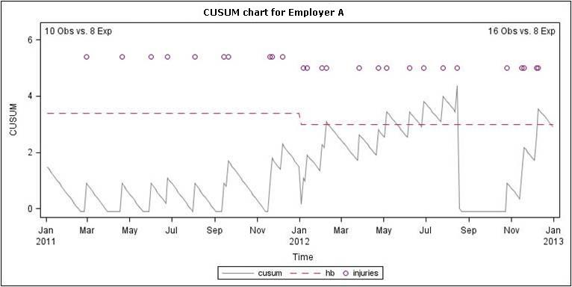
Method 2 – CUSUM Demonstration

Slide 9
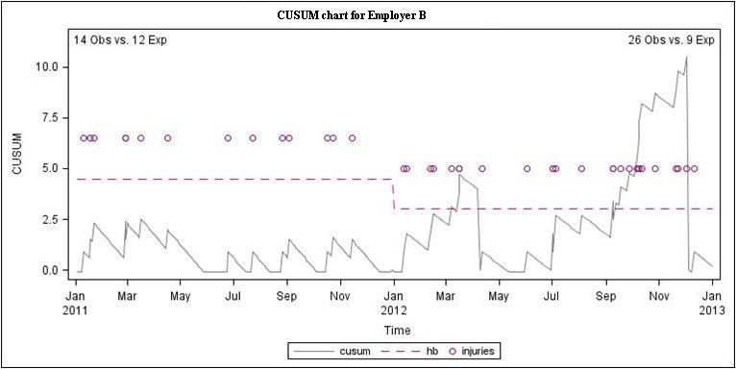
Method 2 – CUSUM Demonstration

Slide 10
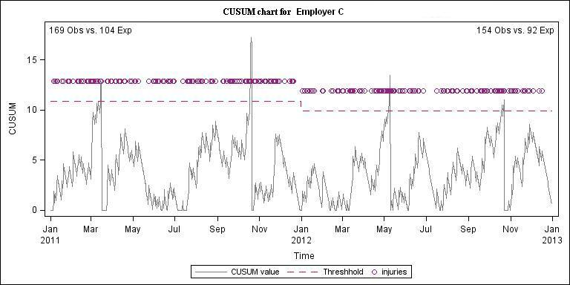
Method 2 – CUSUM Demonstration

Slide 11
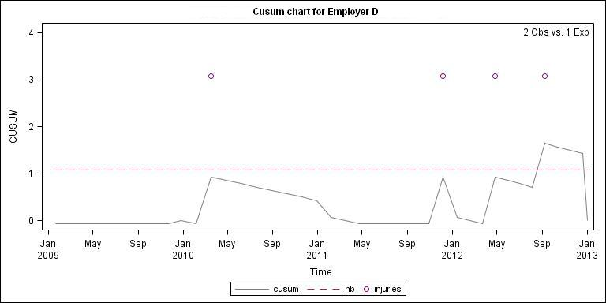
Method 2 – CUSUM Demonstration

Slide 12
New Selection Model
Combine the two outputs from Risk Score and CUSUM and we propose the following model:
For current purpose, we focus on the most risky category (circled in green)

Slide 13
New Selection Model Outcome
Summary statistics on 2012 active employers
  232,587 Active as of 2012 year end: 72,843 with minimum 5 FTE (31%)
Measures: 1) % targeted out of total 2012YE active;
2) Average Cost per firm for the risk category;
3) % cost from targeted firm out of total 2012 new claim costs (schedule 1)
611 firms were identified as high risk by both methods.

Slide 14
Next Steps
CUSUM - Expansion of the scope to provide real time monitoring
Potential to focus on serious injuries or high impact injuries
Potential industry and accident type specific strategy
Implementation and evaluation plan

